Slide 1




Final Project
2023
Dashboard - Power BI & Tableau
Team 8
Irene Lau
Benjamin Chan

Slide 2


Bestmart 360 & 759 store

Slide 3
https://www.ypppt.com/
PART 01
Introduction
Catalogue
PART 02
Company Background
PART 03
EDA (Web Scraping)
PART 04
Tableau & Findings
PART 05
Conclusion

Slide 4

01
Introduction

Slide 5
Introduction
INTRODUCTION:
In recent years, retailing business has became very popular in Hong Kong, especially the snack business from Japan and South Korea. Among them, there are two chain stores leading the main market in Hong Kong, Bestmart 360 and 759 Store. Therefore, we would like to analyse their success and differences.

Slide 6
Introduction
AIM:
To analyse the differences between Bestmart 360 and 759 Store in the market.

Slide 7
02
Company
Background

Slide 8
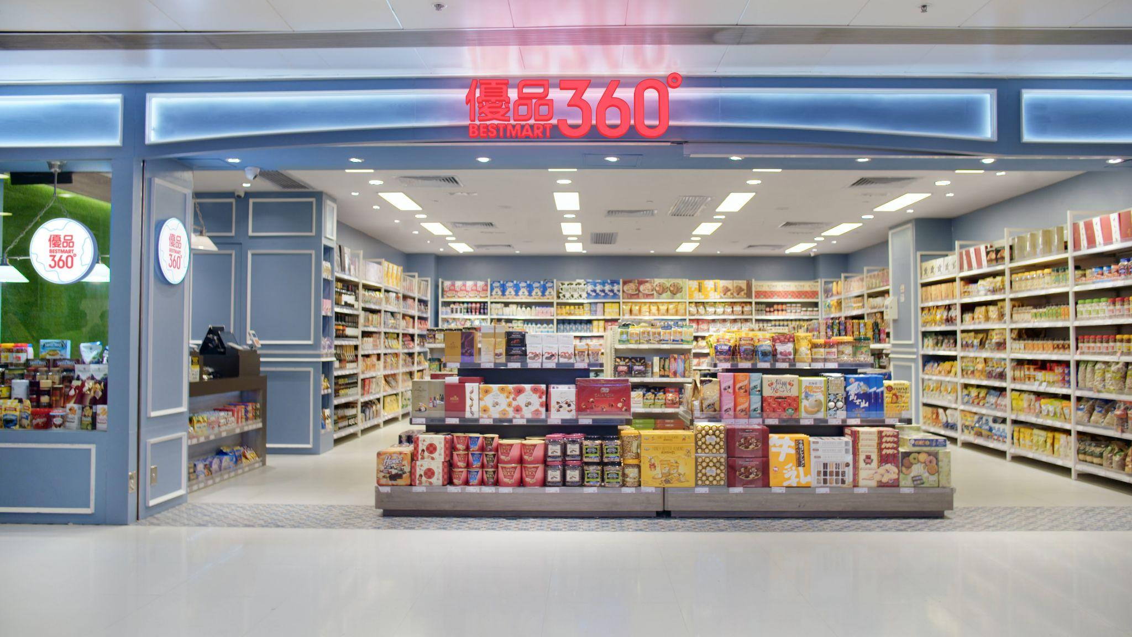
Company Background
Best Masrt 360
Company Background
136
7
2
Hong Kong
Macau
China
leisure food retailer operating chain retail stores under the brand “Best Mart 360˚ (優品 360˚)” since 2013.
objective to offer “Best Quality” and “Best Prices” products to customers through continuous efforts on global procurement with a mission to provide comfortable shopping environment and pleasurable shopping experience to customers.

Slide 9
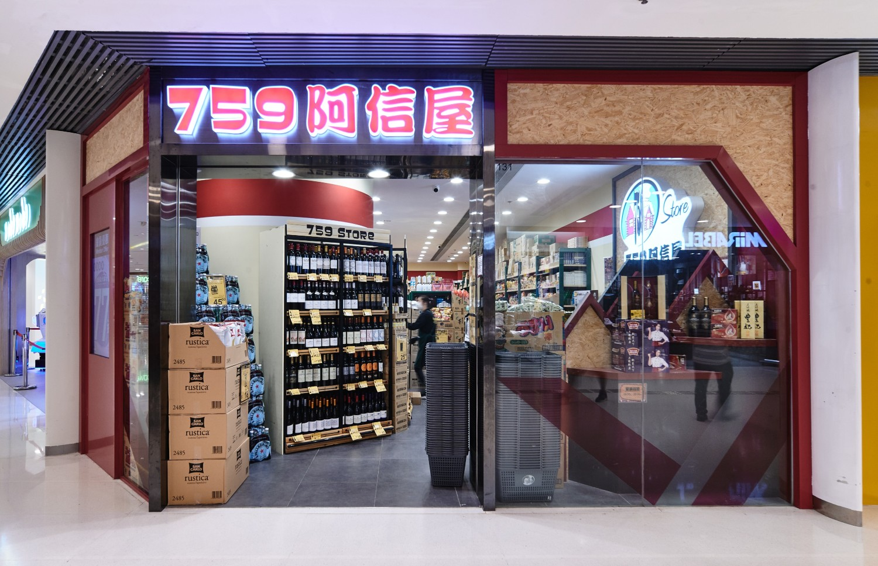
Company Background
759 Store
Company Background
170
Hong Kong
chain store selling groceries and snacks since 2010
The name 759 named after Hong Kong Stock Exchange code of its parent company
mainly sells Japanese, Korean and other foreign food items more cheaply than other supermarkets in Hong Kong.

Slide 10
Company Background
Best Mart 360
759 Store
Stock Code : 02360 Bestmart360
Stock Code : 759 CEC INTERNATIONAL HOLDINGS LTD.
Headquarters : Hong Kong
Year of establishment : 2013
First Branch : Sheung Shui
Store No. : 136 (Hong Kong)
Business :
Japan & Korean Snacks Retail
Headquarters : Hong Kong
Year of establishment : 2010
First Branch : Kwai Chung
Store No. : 170 (Hong Kong)
Business :
Japan & Korean Snacks Retail
& groceries
Difference between
BestMart 360 and
759 Store
点击添加标题

Slide 11
03
EDA
(Web Scraping)

Slide 12
EDA (Web Scraping)
01
02
03
04
Visit
Data
Web Scraping
Analysis
https://www.bestmart360.com/
&
https://https://www.759store.com/
HKEXnews
Listing Documents (2016)
Annual Report (2016-2022)
Tableau
Store Location

Slide 13
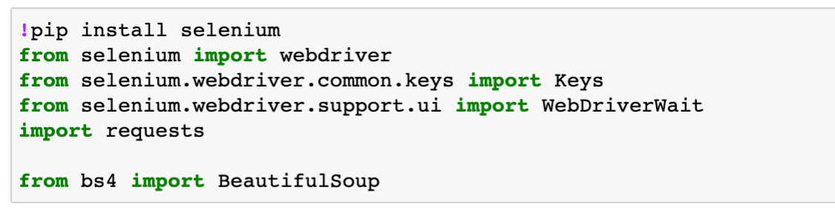
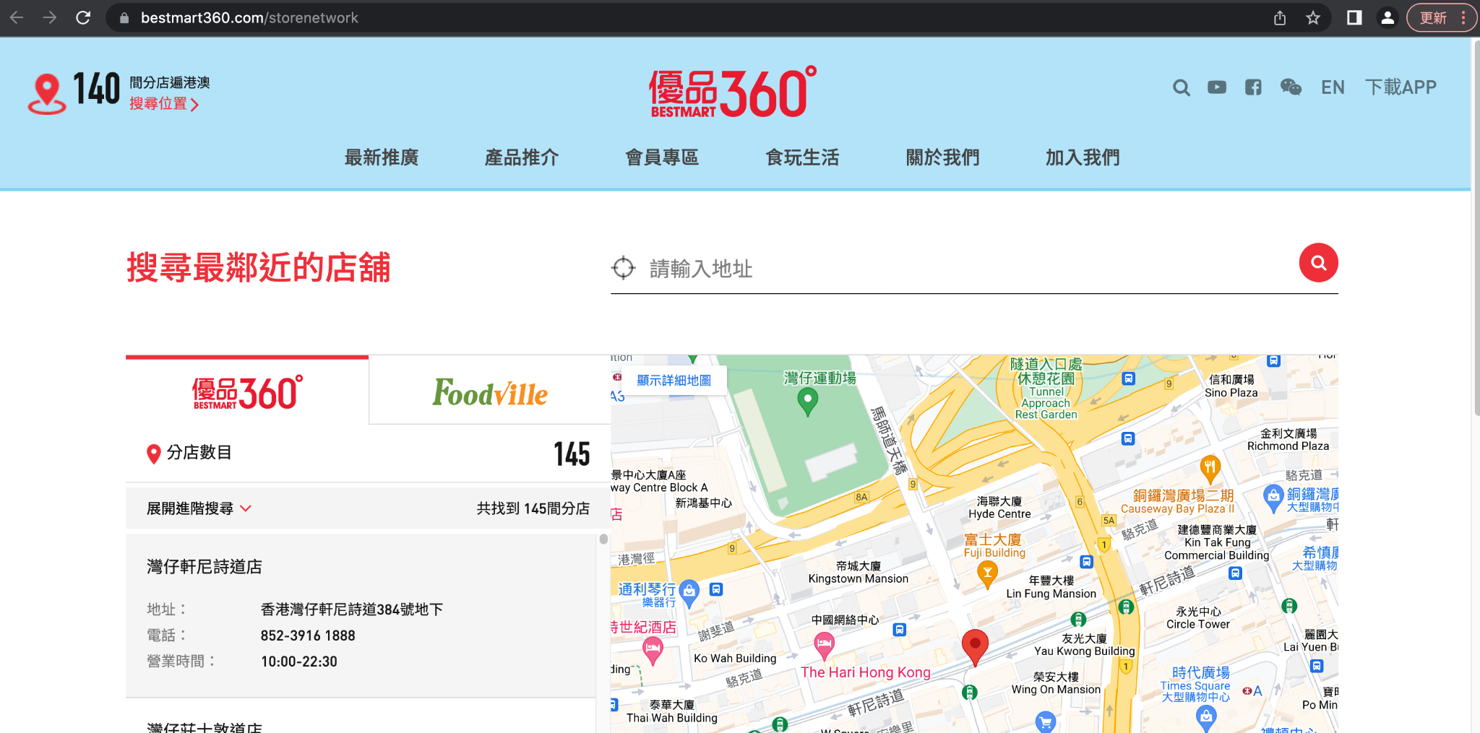
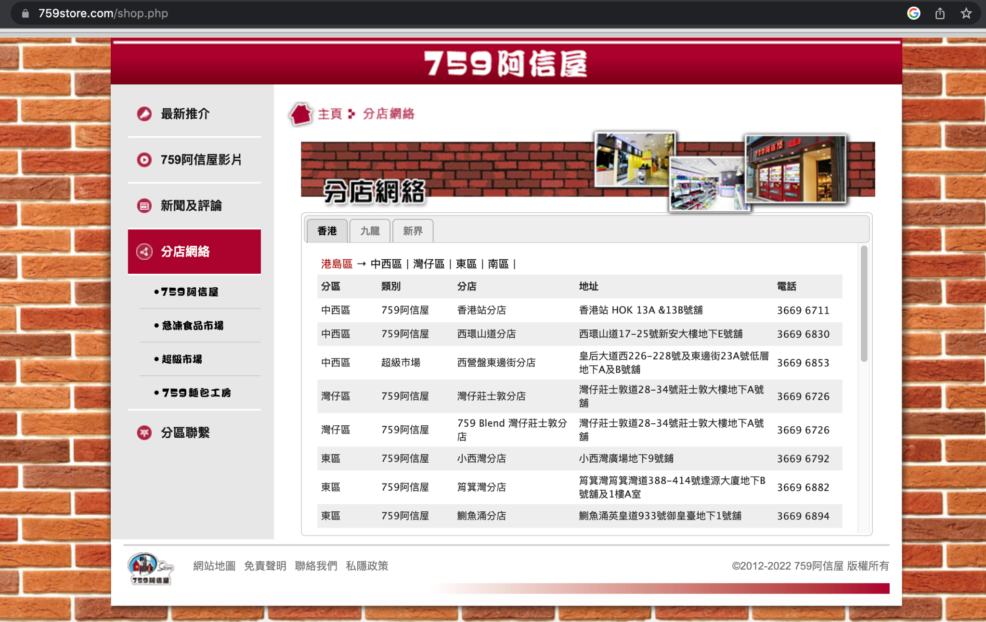
EDA (Web Scraping)
Store Location
A
B
C
https://www.bestmart360.com/storenetwork
https://www.759store.com/shop.php

Slide 14
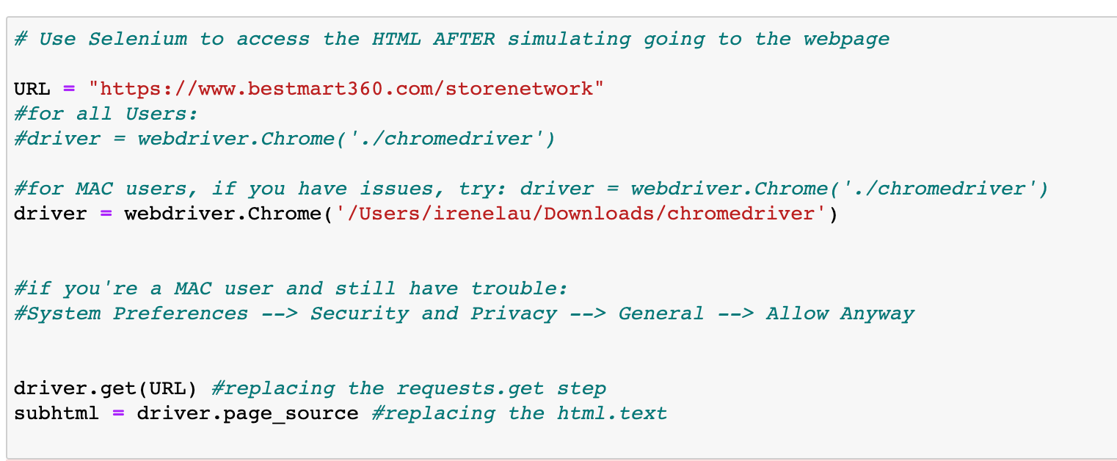

EDA (Web Scraping)
Store Location

Slide 15
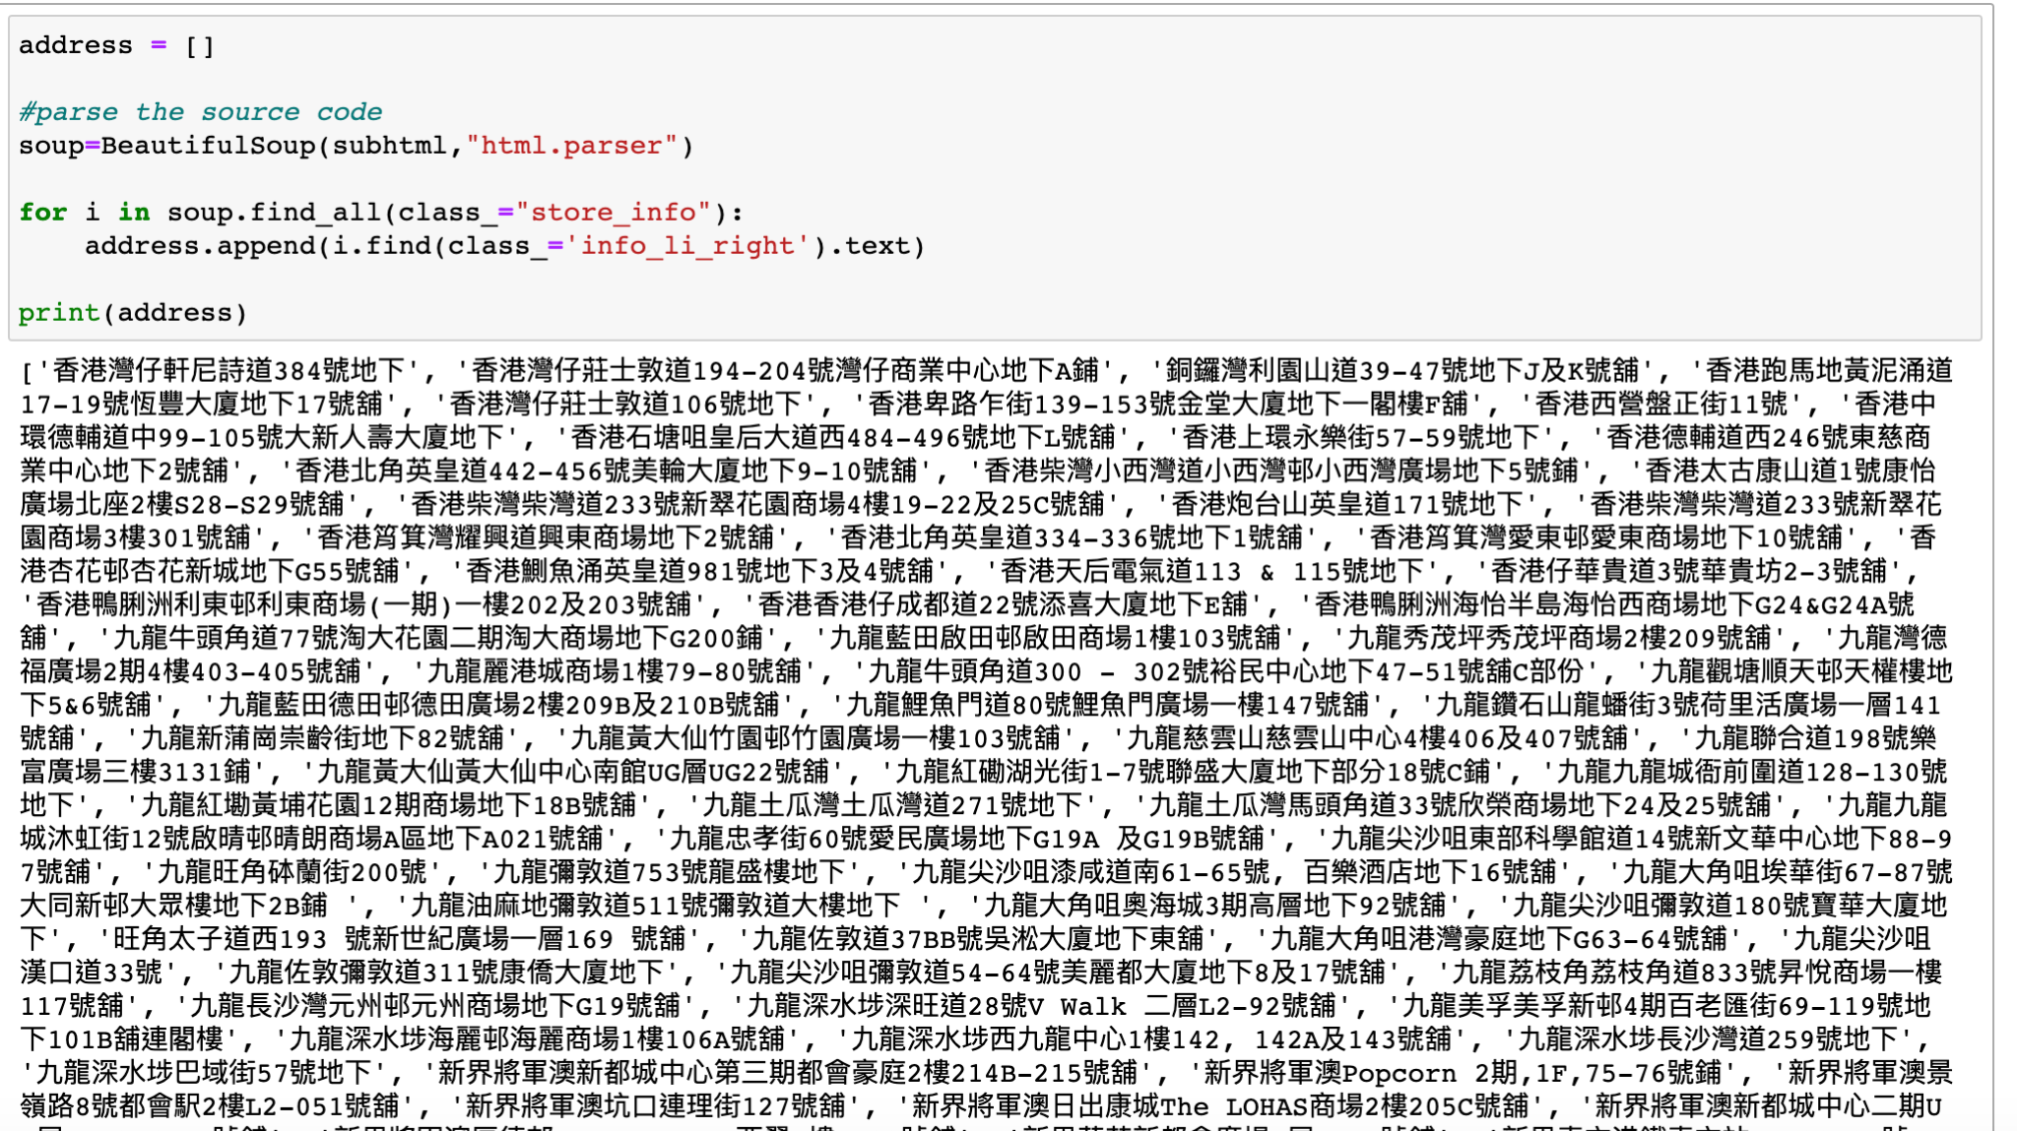
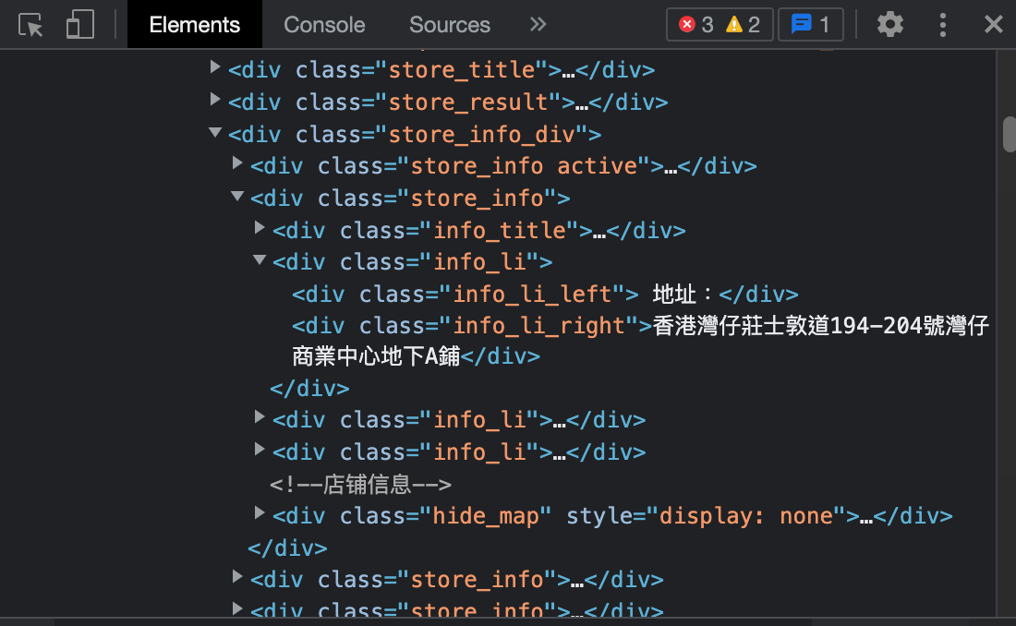
EDA (Web Scraping)
Store Location

Slide 16
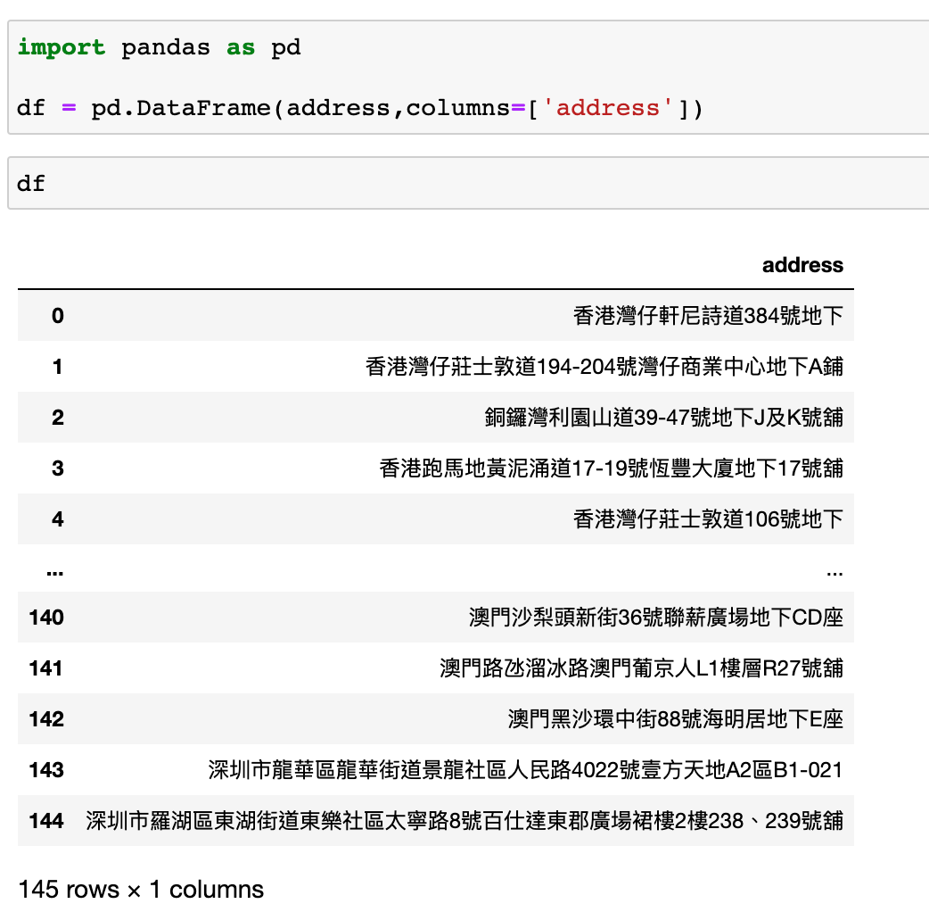
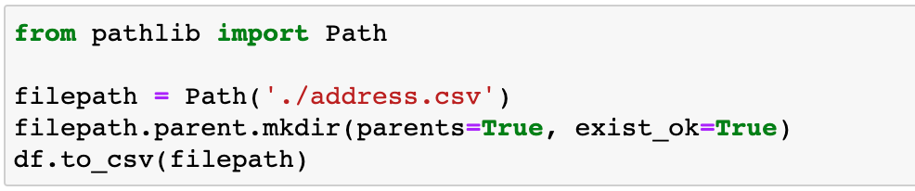
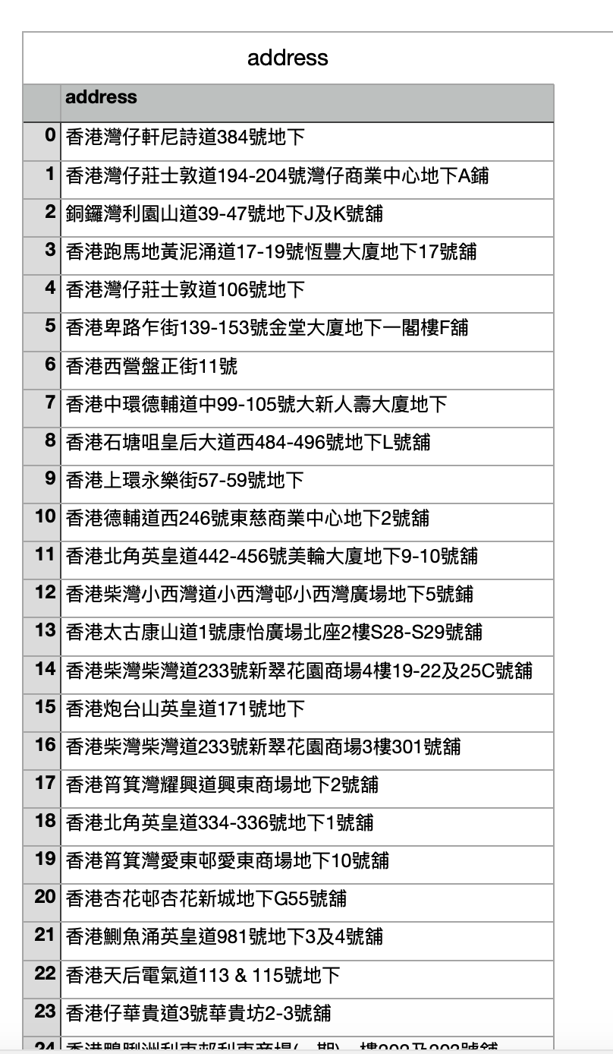
EDA (Web Scraping)
Store Location
CSV
Store Location

Slide 17
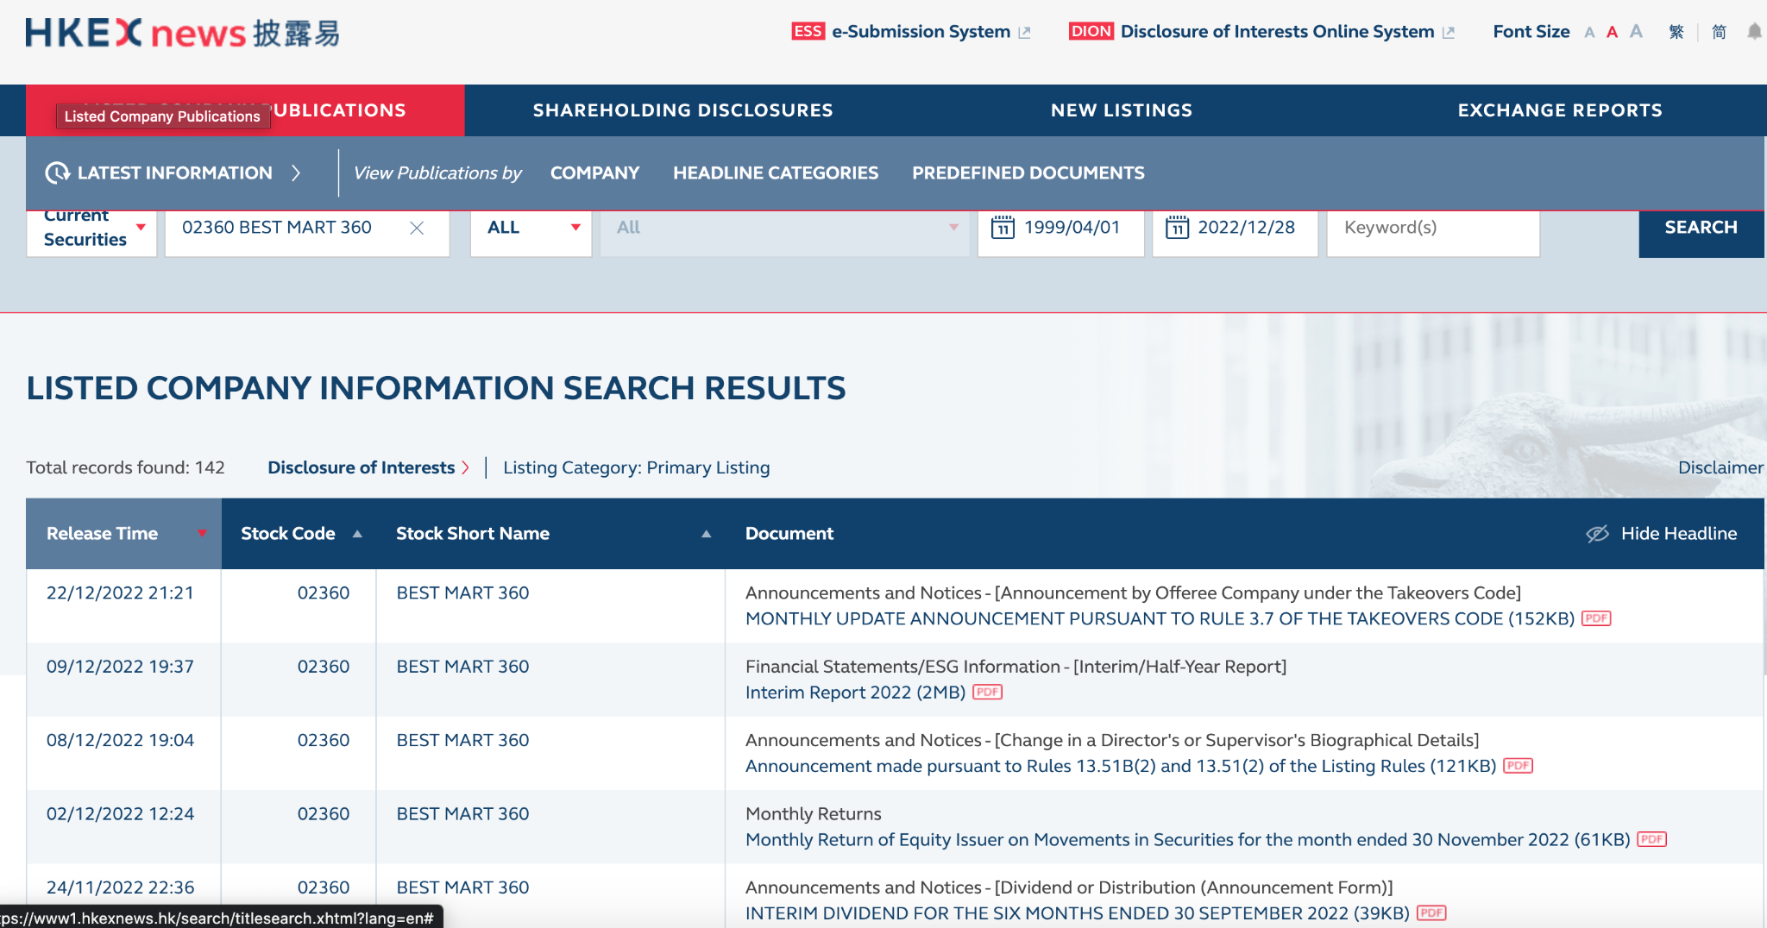
EDA
Data
Other Data Source
https://www1.hkexnews.hk/search/titlesearch.xhtml?lang=en
Listing Documents (2016)
Annual Report (2016-2022)

Slide 18
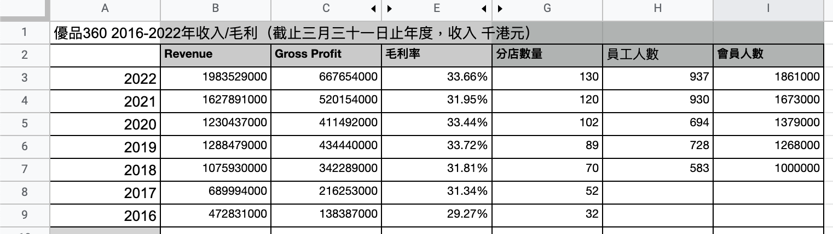
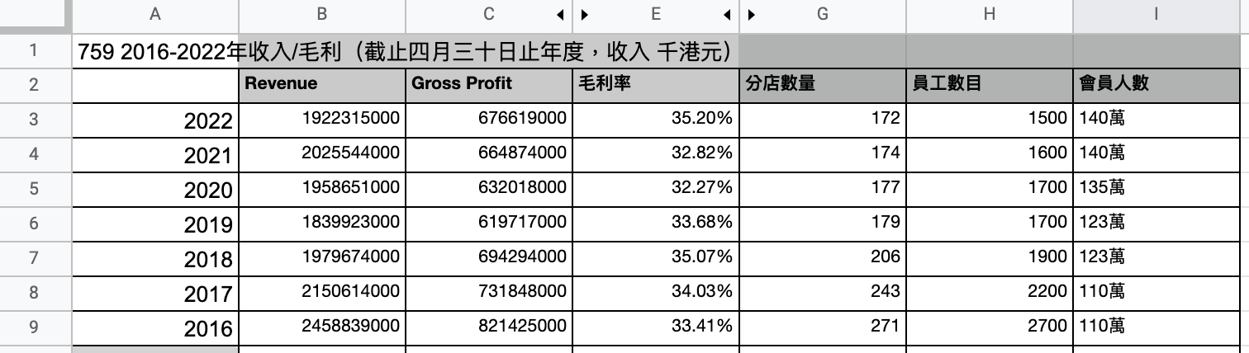
EDA
Data
Bestmart 360:
759 Store:

Slide 19
04
Tableau
& Findings

Slide 20
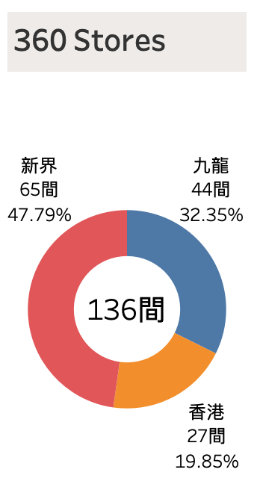
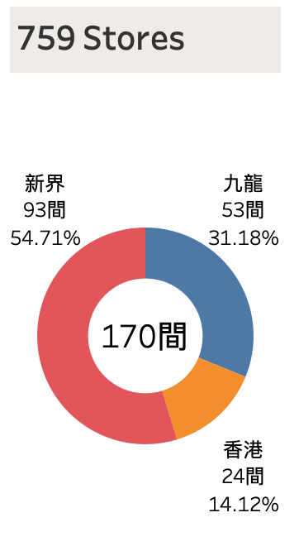
Tableau & Findings
Total 170 > 136
New Territories
V
Kowloon
V
Hong Kong Island

Slide 21
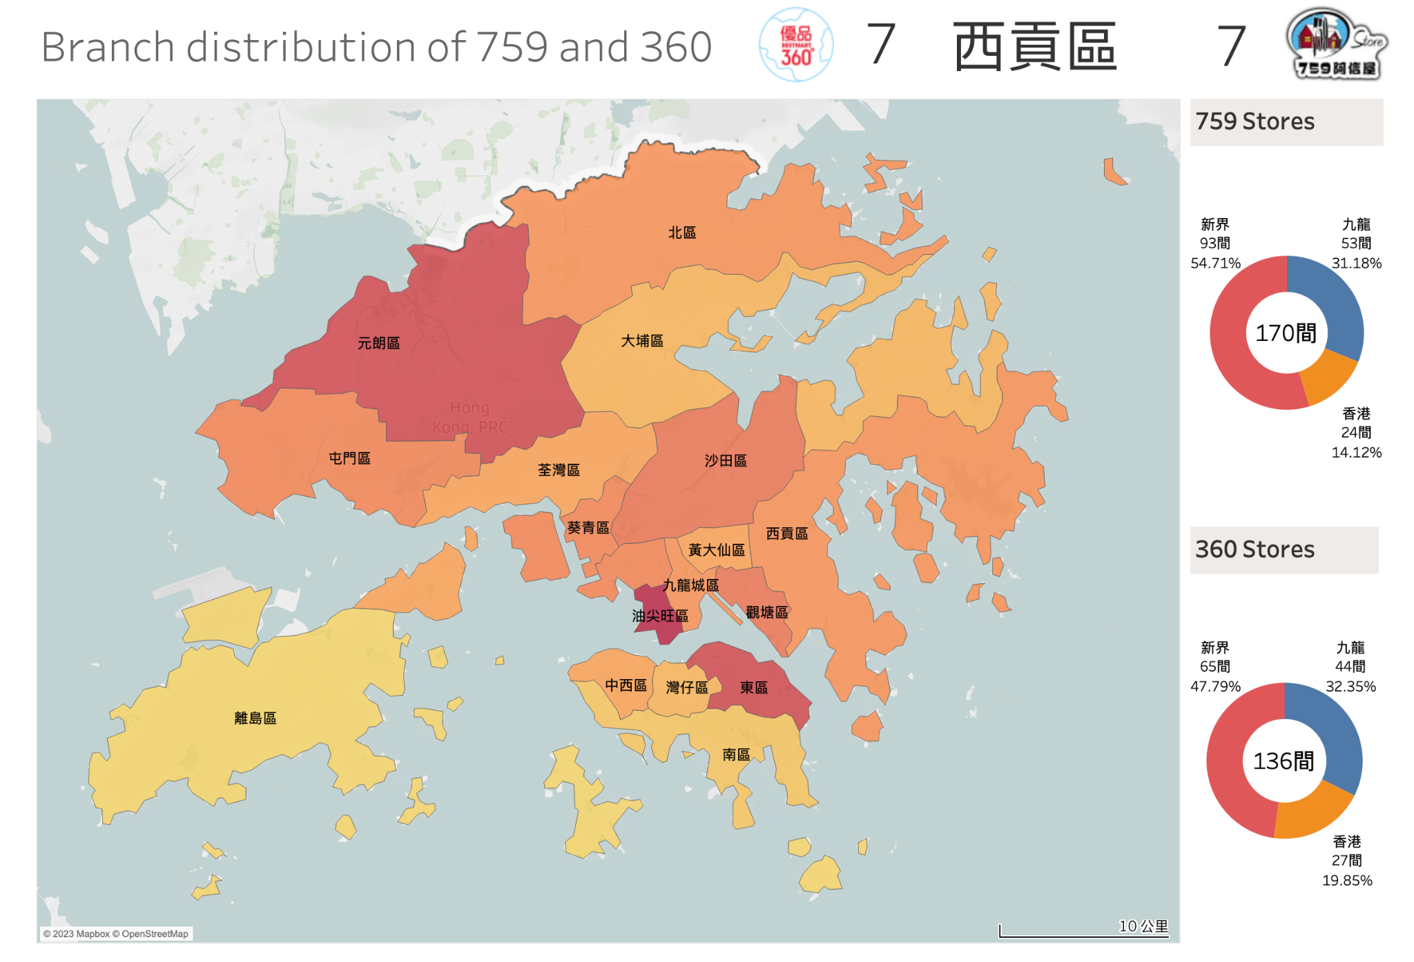
Tableau & Findings
Tableau Link:
https://public.tableau.com/app/profile/irenenelau/viz/759360_16736208801390/1?publish=yes

Slide 22
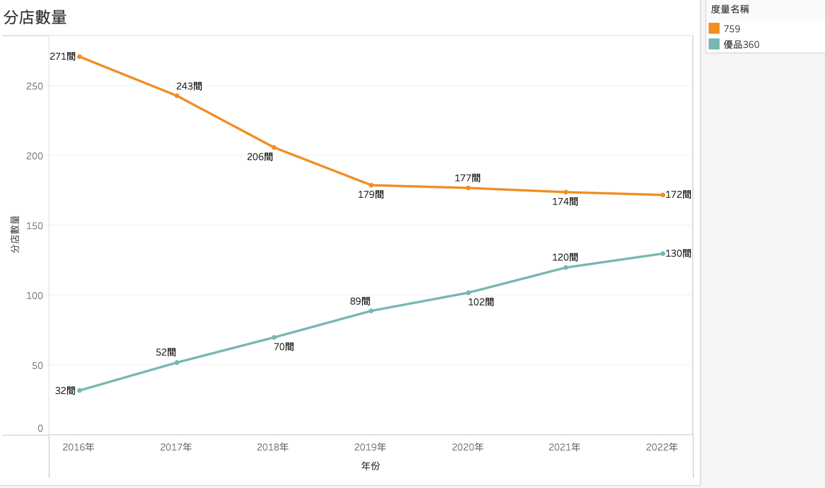
Tableau & Findings
2018
Coils Lam Wai Chun
（1959 - 2018年）
Number of branches
1
2016 -2018
No. of branches is decreasing
1
2
2
>2018
No. of branches remain around 170
3
3
2016-2022
No. of branches is increasing

Slide 23
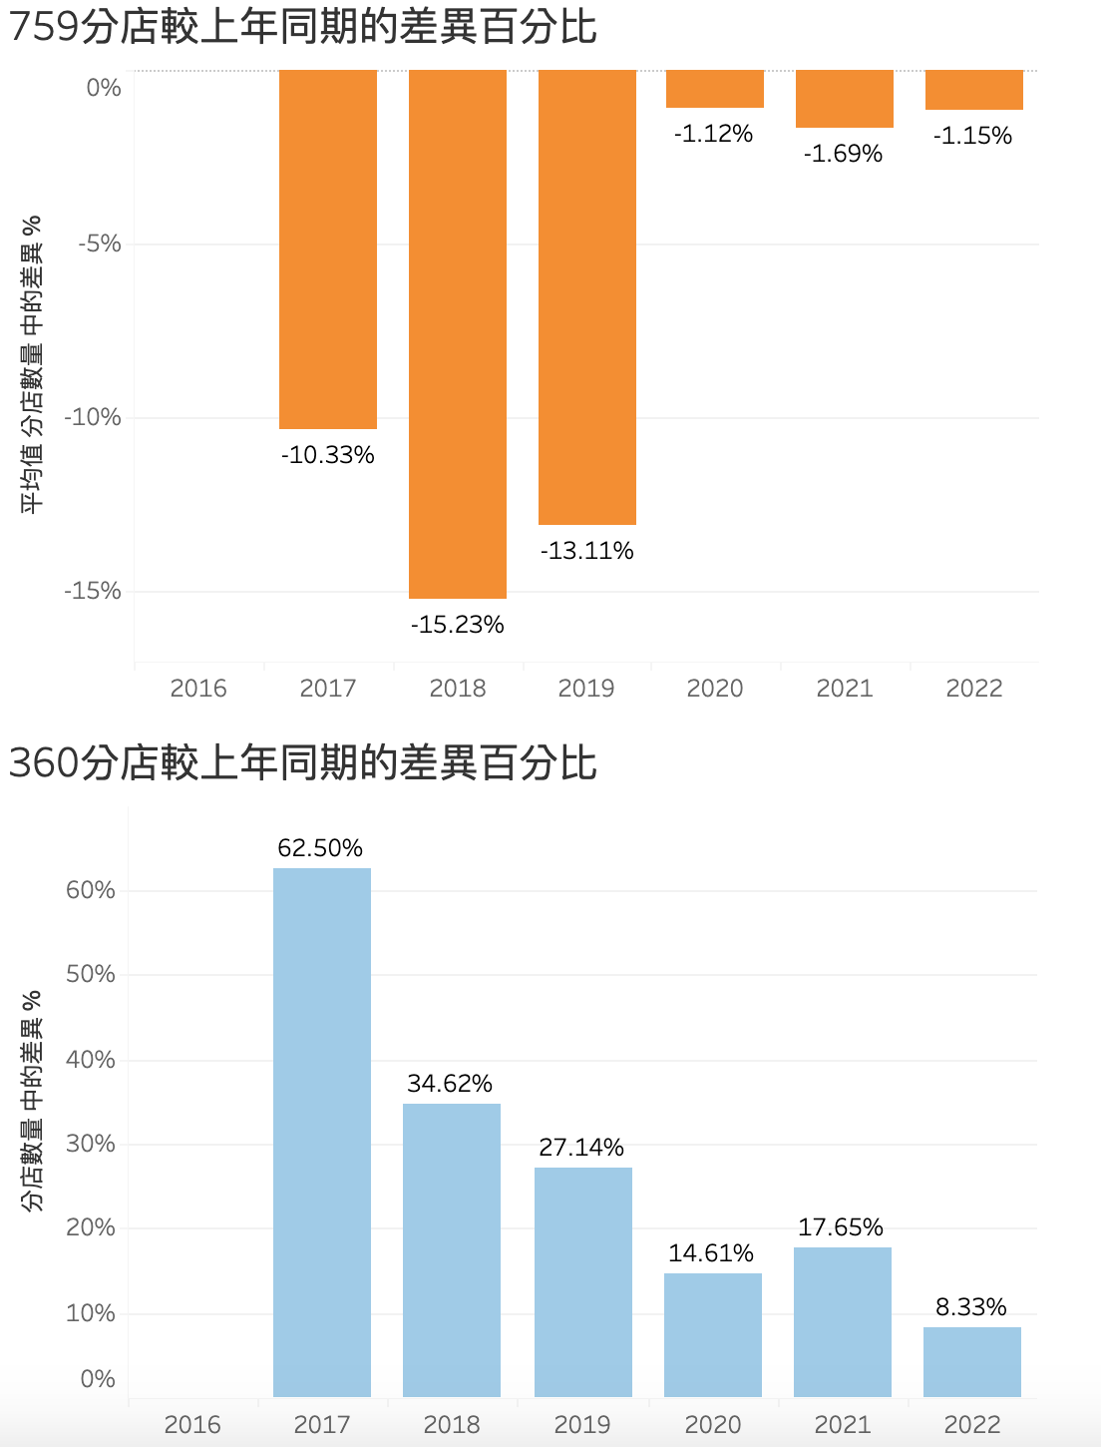
Tableau & Findings
At the same period...
（2017-2019）
1
1
No. of branches decreased by 10%-15%
3
2
No. of branches has increased 27%-62%
（2020-2022）
3
No. of branches decreased by 1%
2
4
4
No. of branches has increased by 10%

Slide 24
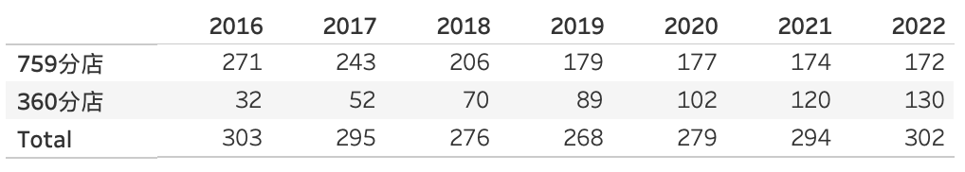
Tableau & Findings
Market Shares
From 2016 to 2022
759
↓100 Branchs
↑100 Branchs
360

Slide 25
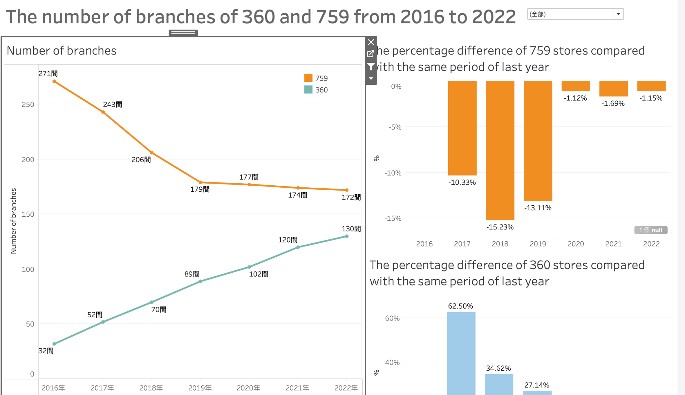
Tableau & Findings
Tableau Link:
https://public.tableau.com/app/profile/irenenelau/viz/2016-2022360759/sheet4?publish=yes

Slide 26
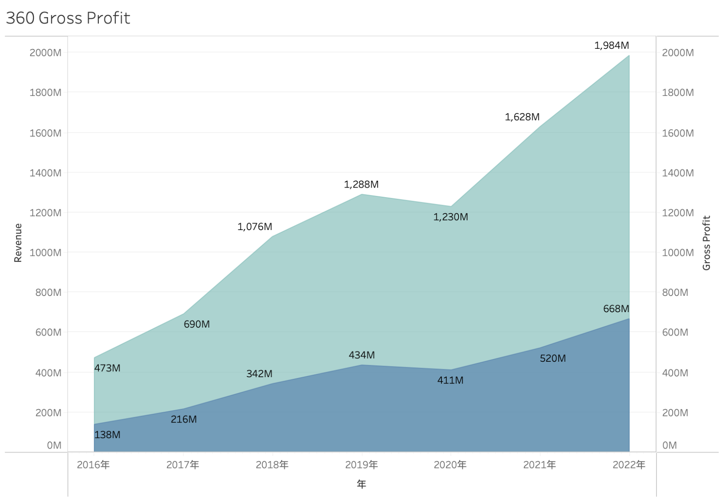
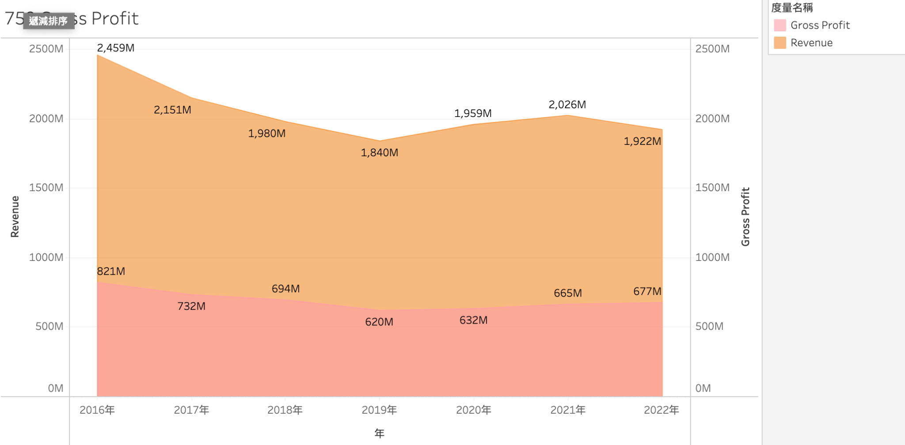
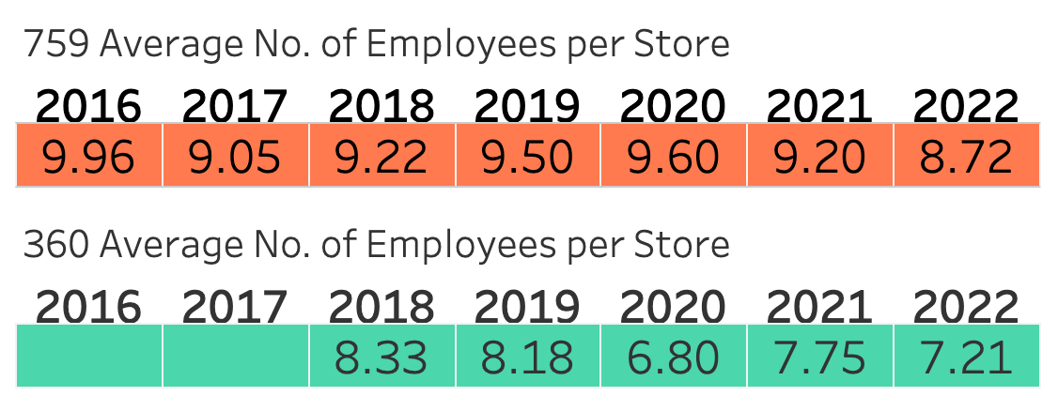
Tableau & Findings
Profit
and Gross Margin of 360 and 759 from
2016 to 2022
More
Less

Slide 27
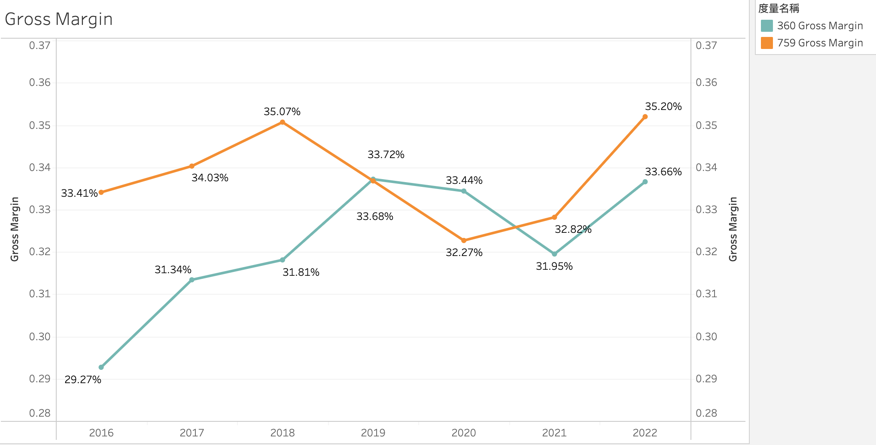
Tableau & Findings
The average gross profit margins of both werearound 30%

Slide 28
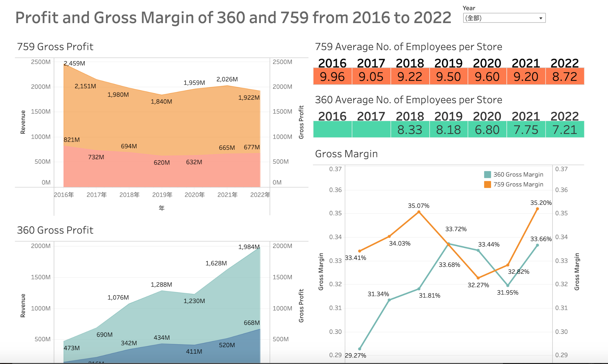
Tableau & Findings
Tableau Link:
https://public.tableau.com/app/profile/irenenelau/viz/759360/1?publish=yes

Slide 29
05
Conclusion

Slide 30

Conclusion
Conclusion
Conclusion
Market share is close to saturation
The average gross profit margin of both were around 30%
No. of branches remain around 170
360 co. has better labor cost control
759 co. has a higher gross profit rate
Gross profit rate is increasing
759 Store
Best Mart 360

Slide 31
THANK YOU
THANK YOU

